Slide 1
Project 4 -
Machine Learning Integration
Group 6:
Gerardo Angulo, Justin Ho, Rebecca Watson, Ray Yoon

Slide 2
795,000
People every year in the US have a stroke
About 610,000 of these people are first or new strokes.
According to the CDC website:
https://www.cdc.gov/stroke/facts.htm
Notes:
Meaning there are a lot of people at risk of having a stroke and they might not be aware of it.

Slide 3
Early action is important for strokes
Know the warning signs and symptoms of stroke so that you can act fast. The chances of survival are greater when emergency treatment begins quickly.

Slide 4
Background
Our team at the medical research facility has been researching brain strokes. We created a website to help spread awareness and to highlight the main causes of stroke.
Objective
To create a machine learning model that can accurately classify a patient as either at risk of having a stroke or not at risk.
In order to give user’s a tool to identify whether they are at risk of having a brain stroke or not.

Slide 5
ROADMAP
Find Data Sources
Analyze Data
Data Model Optimization
1
3
5
2
4
6
ETL
Data Model Implementation
Visualizations
Notes:
Thoughts on the steps for the road map? Should we change or add any steps?

Slide 6
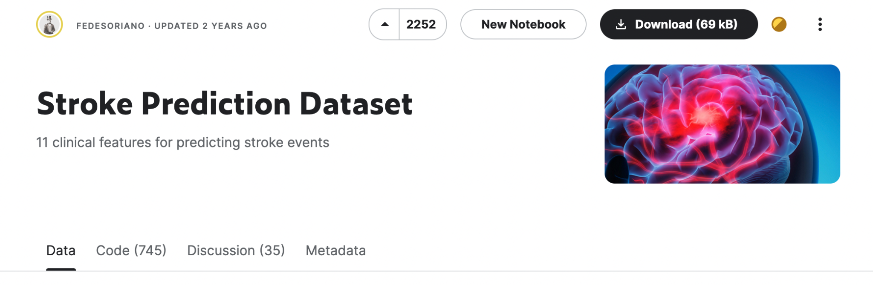
Data Source
1
Link: https://www.kaggle.com/datasets/fedesoriano/stroke-prediction-dataset

Slide 7
ETL & Data Delivery
2

Slide 8
ETL
Converted csv dataset to pandas dataframes
Checked data types and data values for each column
Converted all binary columns to have 0 and 1 data values
Checked ID column for any duplicates
Removed any unnecessary columns (i,e. ID column)
Checked every column for null values
Converted BMI null values (201 or 4% of values) to predicted values
Load encoded data to a sqlite database
Notes:
Explain the process for converting BMI null values into mean values.

Slide 9
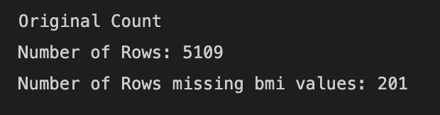
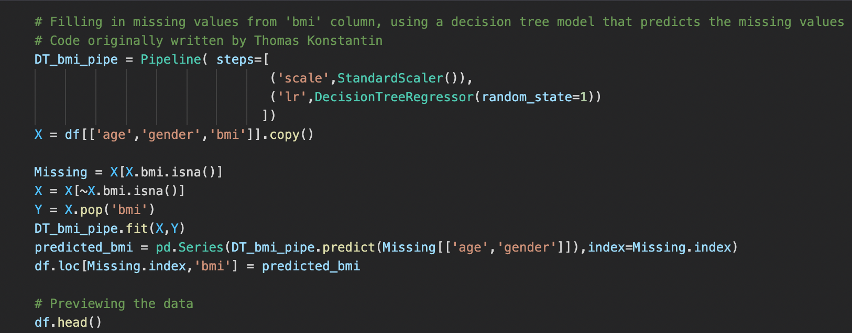
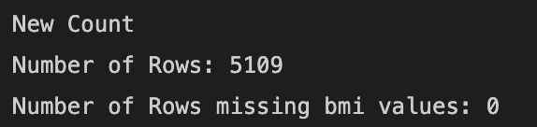
Filling in Missing Values from ‘bmi’ Column
Using a decision tree model that predicts the missing values
Code originally written by Thomas Konstantin

Slide 10
Analyze Data
3

Slide 11
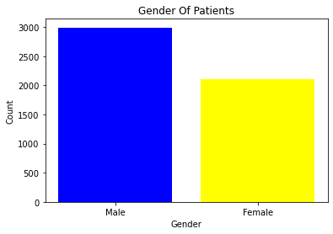
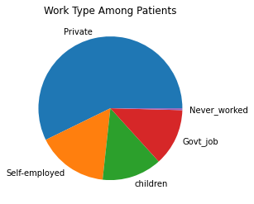
Exploring the Data

Slide 12
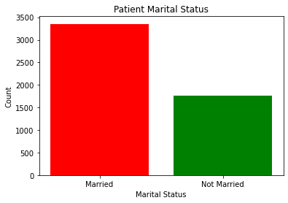
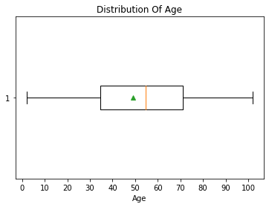
Exploring the Data

Slide 13
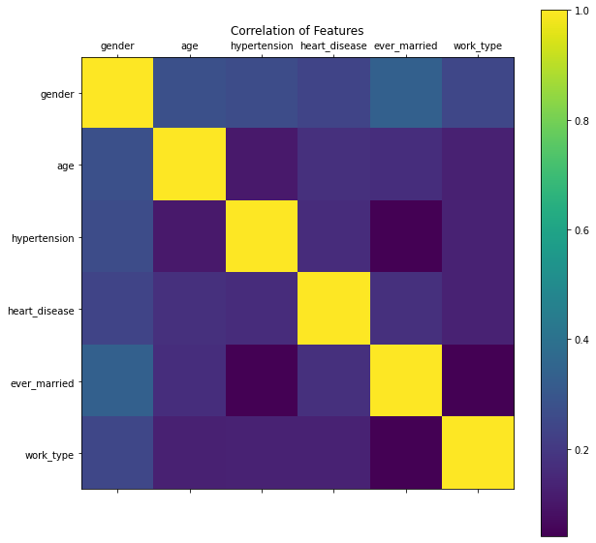
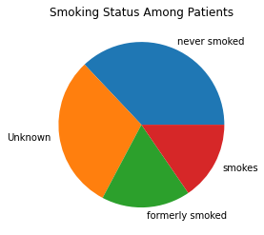
Exploring the Data
Notes:
-speak about how the features in the dataset have little to no correlation to one another.

Slide 14
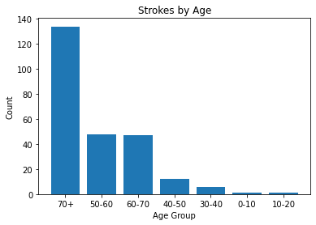
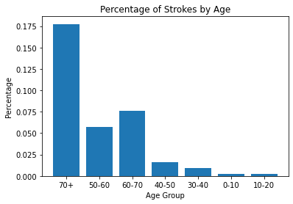
Exploring the Data

Slide 15
Machine Learning Model Implementation
4
Notes:
-convert categorical data into numerical data
-standardize the data
-resolve missing bmi values
-resolve imbalance of no stroke records compared to stroke records

Slide 16
Preprocessing the Data
-Convert categorical data using pd.get_dummies()
Split data into training and testing sets
-Standardize the data using StandardScaler()

Slide 17
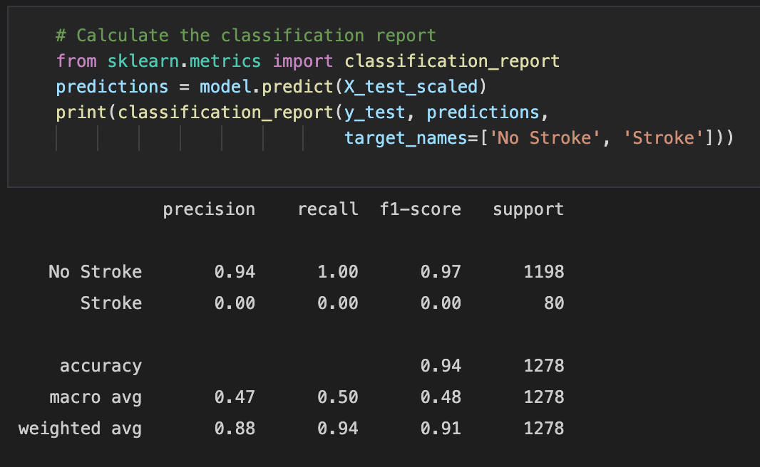
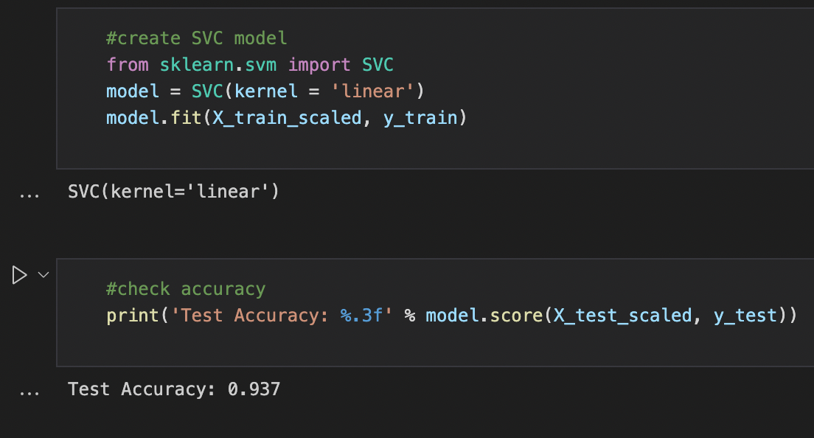
Initial Model
We used SKLearns SVC model

Slide 18
Machine Learning Model
Optimization
5
Notes:
Explain the process for converting BMI null values into mean values.
-show before and after count of BMI

Slide 19
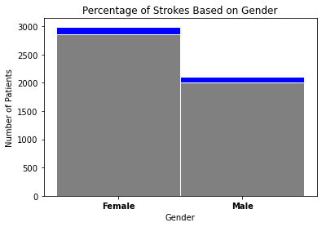
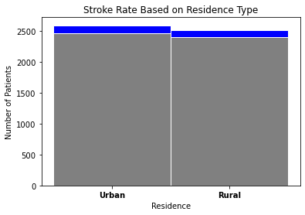
Imbalanced Dataset
Notes:
Very few stroke results compared to the amount patients in the dataset.
Talk about how we solved the issue of an imbalanced dataset.

Slide 20
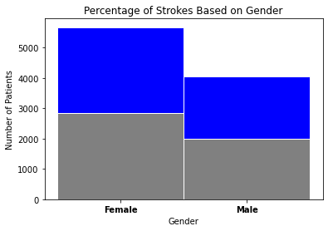
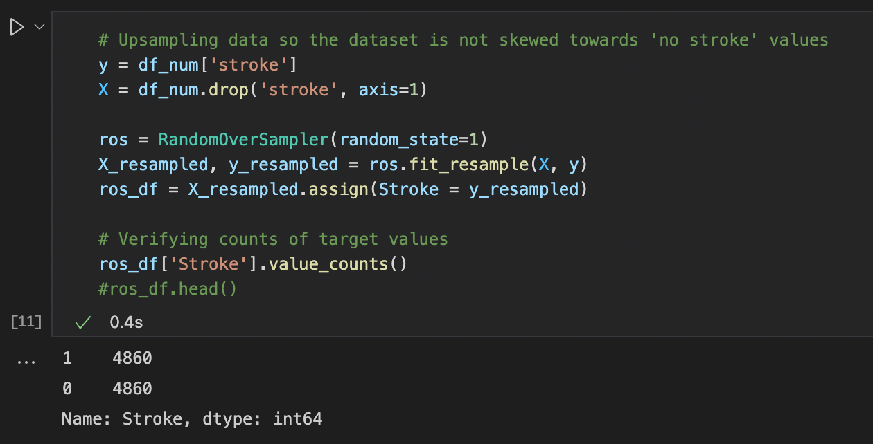
Addressing the Imbalanced Dataset
Upsampling data so the dataset is not skewed towards ‘no stroke’ values
Notes:
-Using the RandomOverSampler function from the imblearn library
-

Slide 21
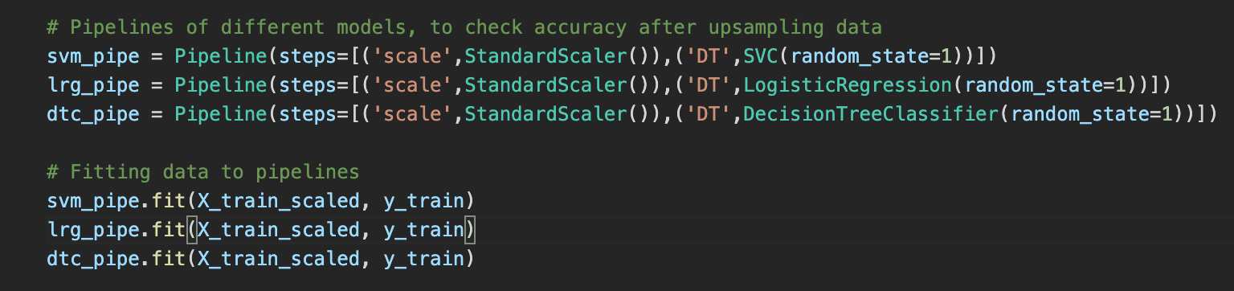
Trying Different Models
Create a pipeline to streamline the process of creating and testing each model with the processed data
The models we tried were:
SVC
Logistic Regression
Decision Tree Classifier

Slide 22
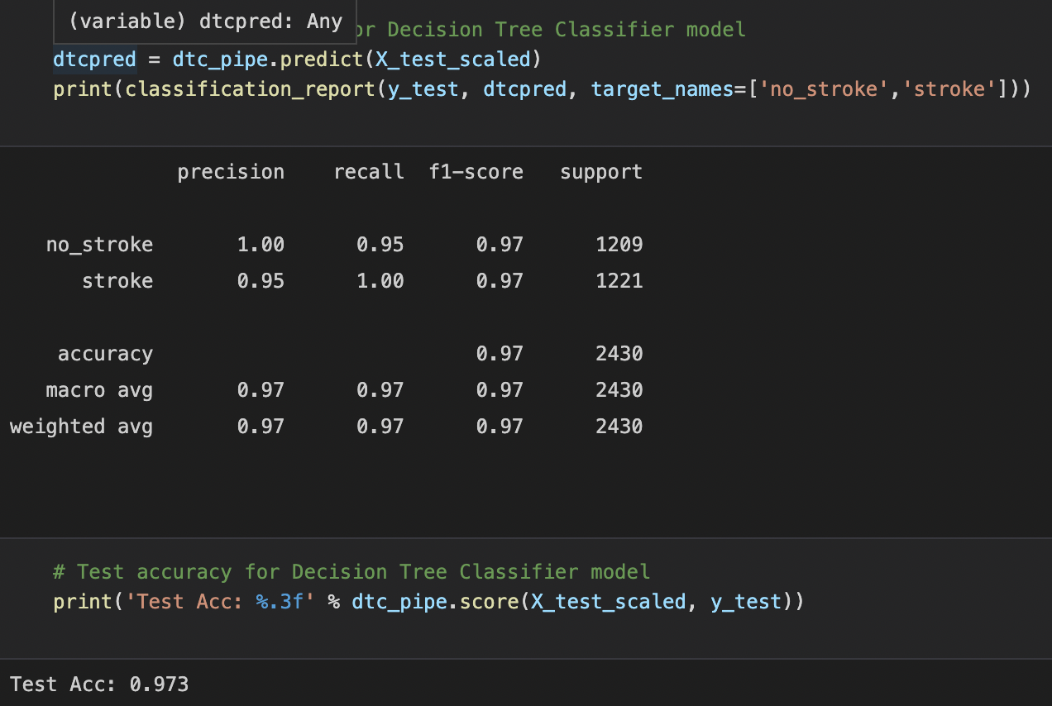
The Most Accurate Model
Random Tree Classifier Model
Accuracy of 97.3%

Slide 23
Website
6
Notes:
HTML
CSS
FLASK

Slide 24
TEAM PRESENTATION
Insert photo here
Insert photo here
Insert photo here
Insert photo here
Gerardo Angulo JOB TITLE
Blue is the colour of the clear sky and the deep sea
Justin Ho JOB TITLE
Blue is the colour of the clear sky and the deep sea
Rebecca Watson JOB TITLE
Blue is the colour of the clear sky and the deep sea
Ray Yoon JOB TITLE
Blue is the colour of the clear sky and the deep sea

